Slide 1

JOT IT DOWN
TO NEVER FORGET.

Slide 2
CONTENTS OF THIS PRESENTATION
FEATURES of V 0.1
FEATURES of V 0.2
UI Design

Slide 3
FEATURES OF V 0.1
Email integration
Modification of tasks
Addition of tasks
Deletion of tasks
Searching a task
Marking a task as DONE
Command Line Input from User
Key word shortcut utility (toggle/activate)
Text files for data storage
Suggesting free time slots.
Suggesting tasks to User

Slide 4
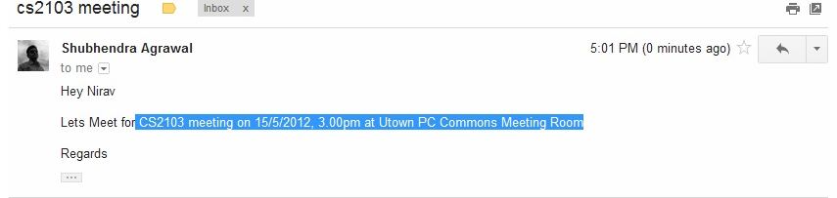
Email Integration
1. Select required text from mailbox.

Slide 5

2. Press the HOT key.

Slide 6
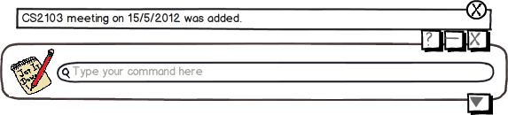
AND IT’S DONE.

Slide 7
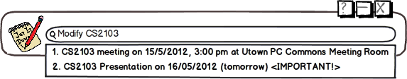
Modification of Tasks
1.Type ‘Modify’ in the command line and search for the task you want to modify.

Slide 8

2. Select the task and Modify it in the command line.

Slide 9
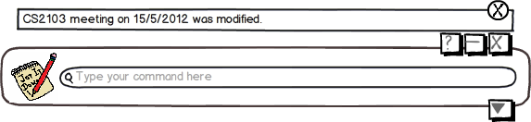
AND It’s DONE!

Slide 10

Addition of Tasks
1. Type ‘add’ followed by the task.

Slide 11
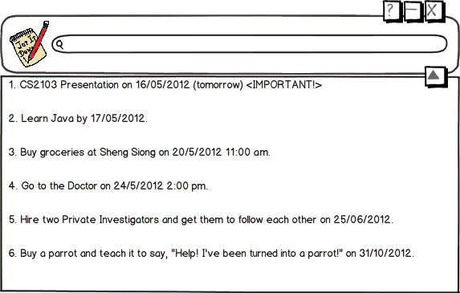
AND It’s DONE.

Slide 12
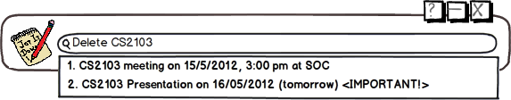
Deletion of Tasks
Search for the Task to be deleted.

Slide 13

2. Select the task

Slide 14
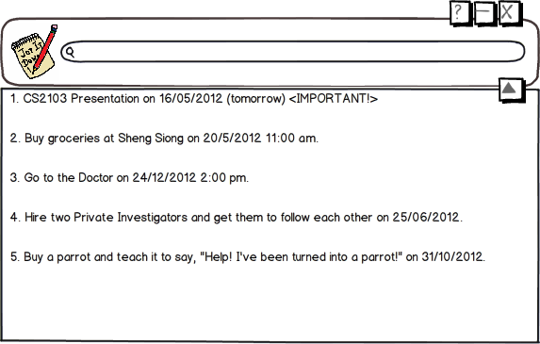
AND IT’s DONE.

Slide 15
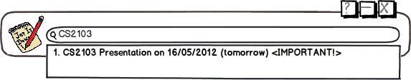
Searching a Task
Type the keyword you want to search for in the command line and select it for details. AND It’s DONE!

Slide 16
Marking a TASK Done

Slide 17
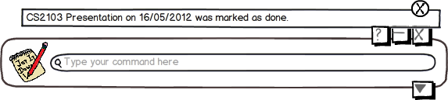
AND IT’s DONE!

Slide 18
Command Line Input from User

Slide 19
Keyword Shortcut Utility

Slide 20
Text Files for Data Storage

Slide 21
Suggesting Free-Time slots

Slide 22
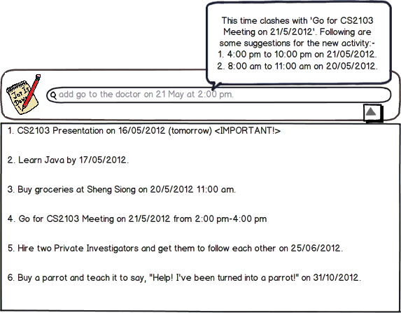

Slide 23

GOOGLE CALENDAR SYNCHRONIZATION
1. Type ‘Login’ in the command line.

Slide 24
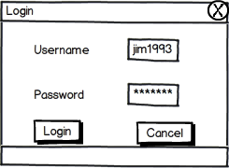
Login using Username and Passoword

Slide 25
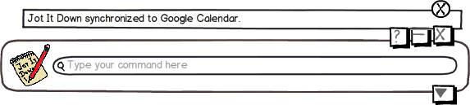
AND IT’s DONE

